Slide 1















Raster Input
Layer-wise SVG Reconstruction (5 paths in total)
Raster Input SVG Output Editing color Editing eyes

Slide 2
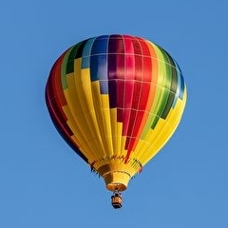





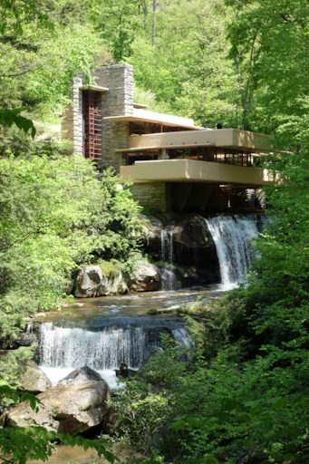
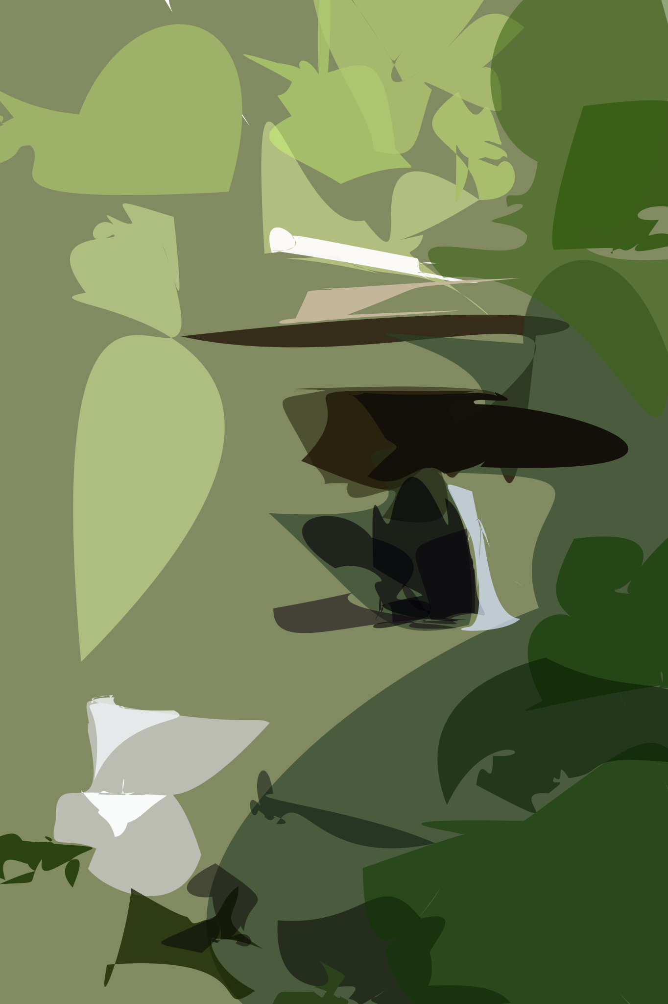
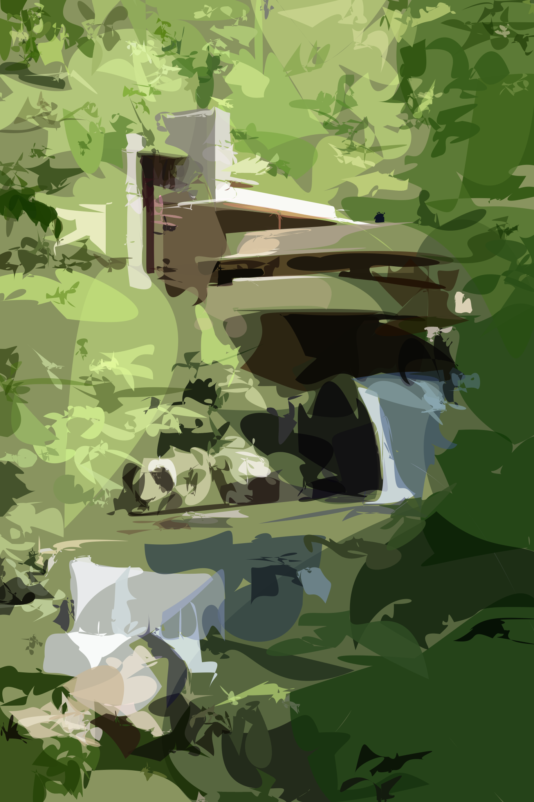
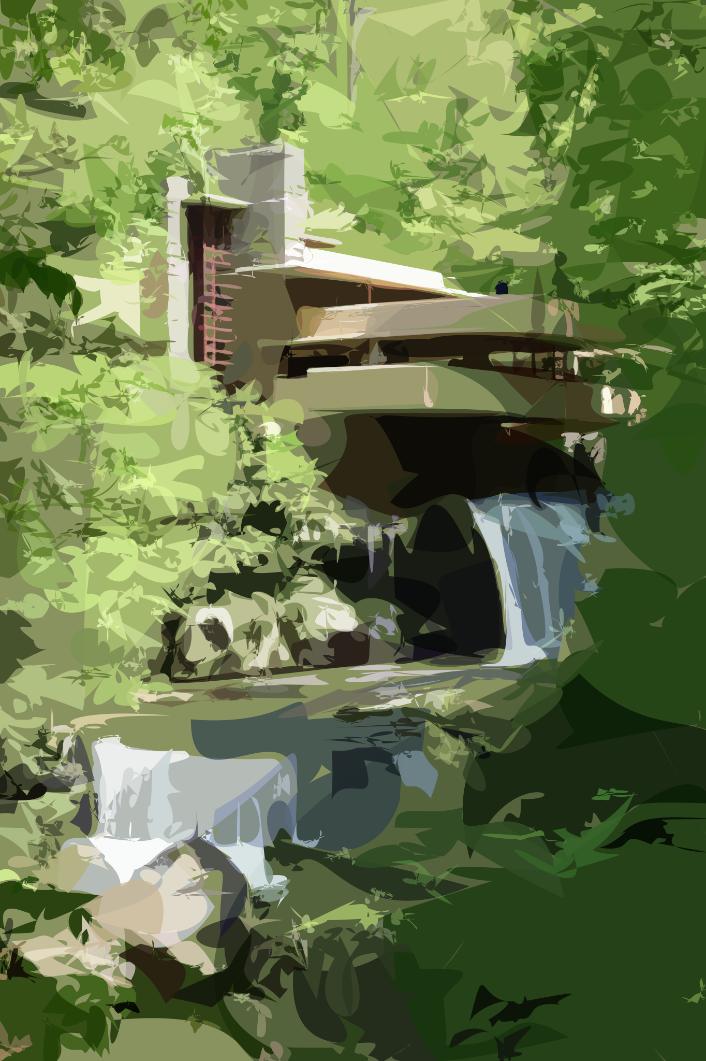
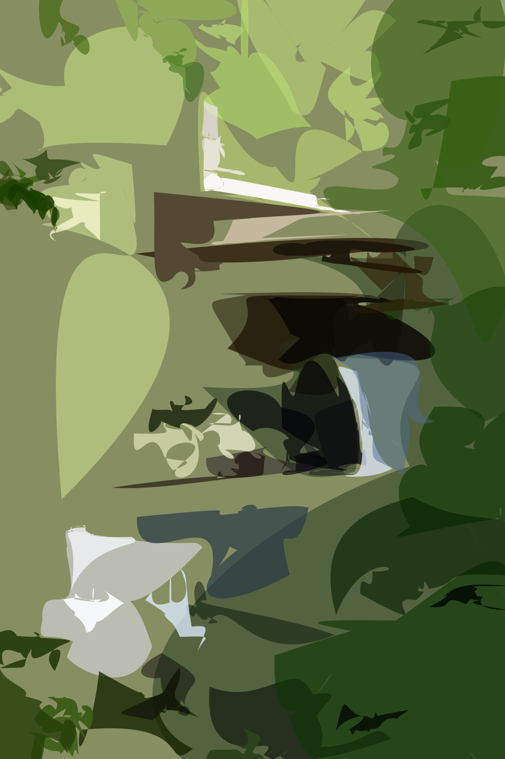
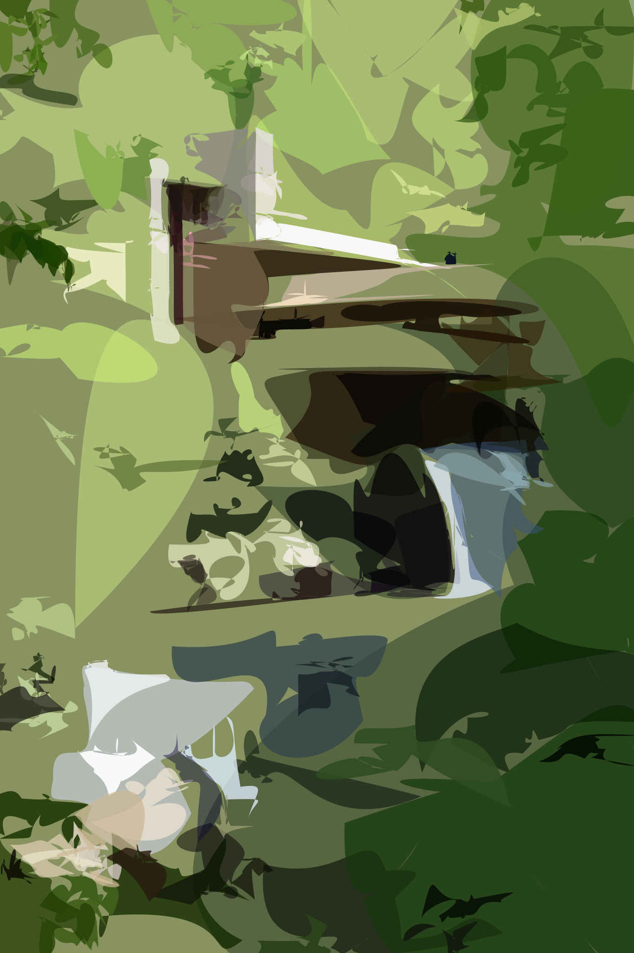
Raster Input
Layer-wise SVG Vectorization (from left to right)

Slide 3
N=10
N=20
N=30
N=40
N=50
Raster Input
N=32
N=64
N=128
N=256
N=512
Layer-wise Image Vectorization (from left to right)

Slide 4


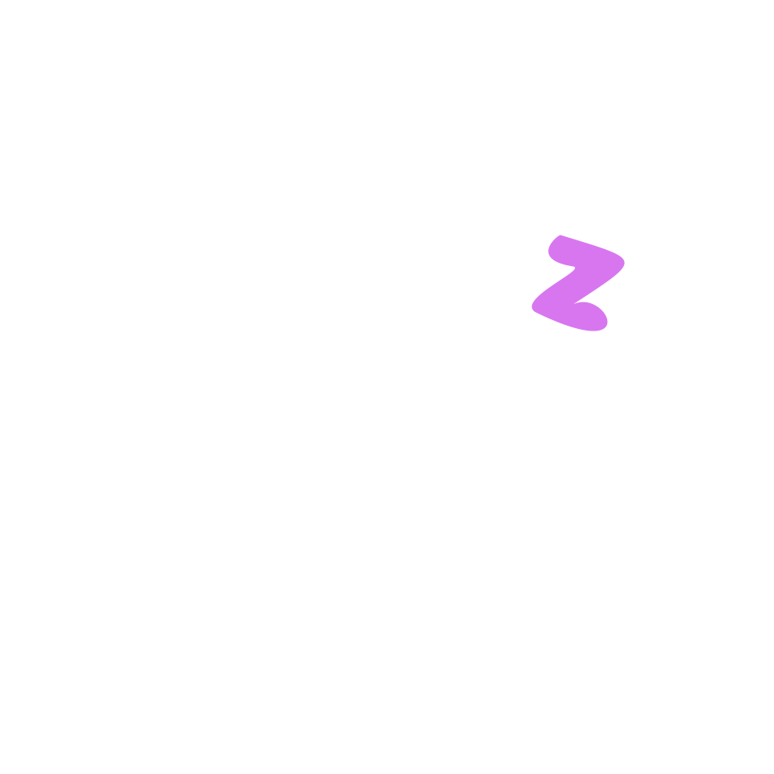






Slide 5







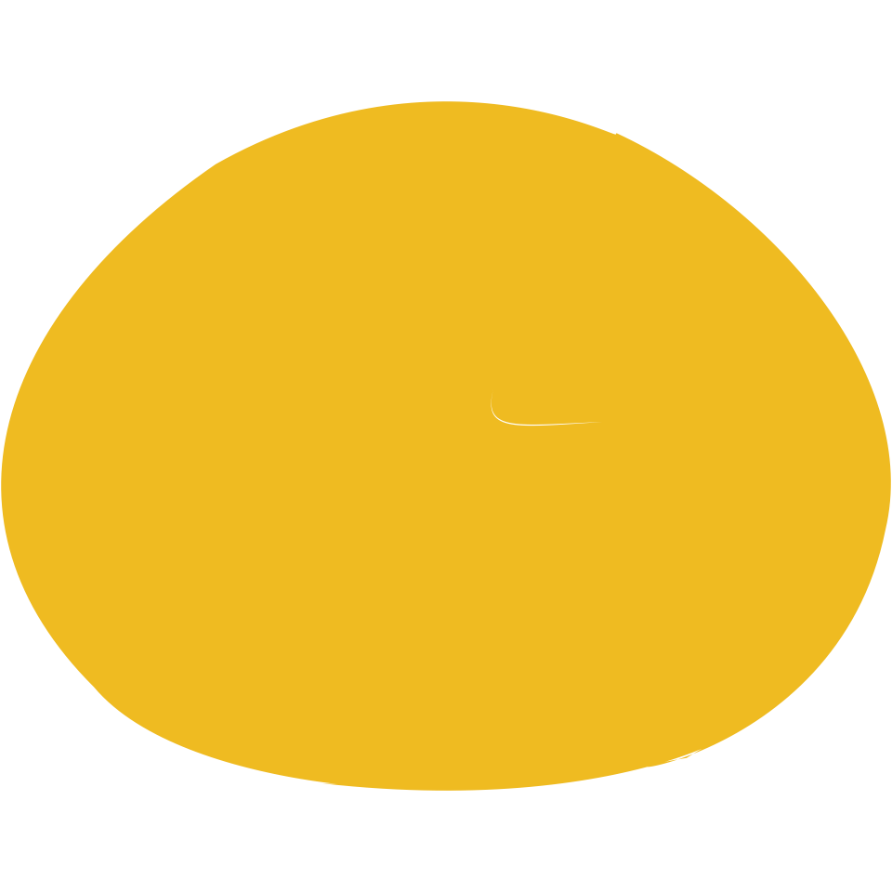








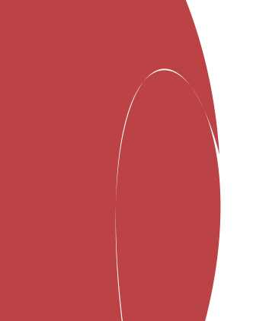
Circle Initialization
Random Initialization

Slide 6







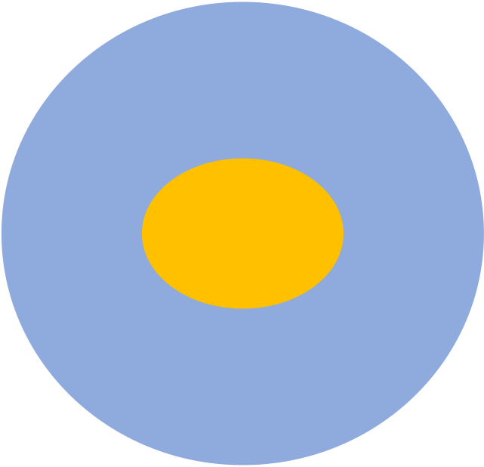

RGB(244,196,72)
RGB(225,179,83)
RGB(244,197,87)
RGB(93,134,194)
RGB(108,126,152)
RGB(86,132,194)
Target
MSE-Loss
UD-Loss
Target
MSE-Loss
UDF-Loss
RGB (93,134,194)
RGB (86,132,194)
SDF loss

Slide 7









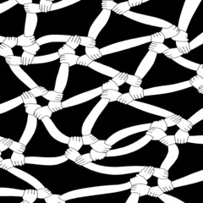

Emoji
Pics

Slide 8






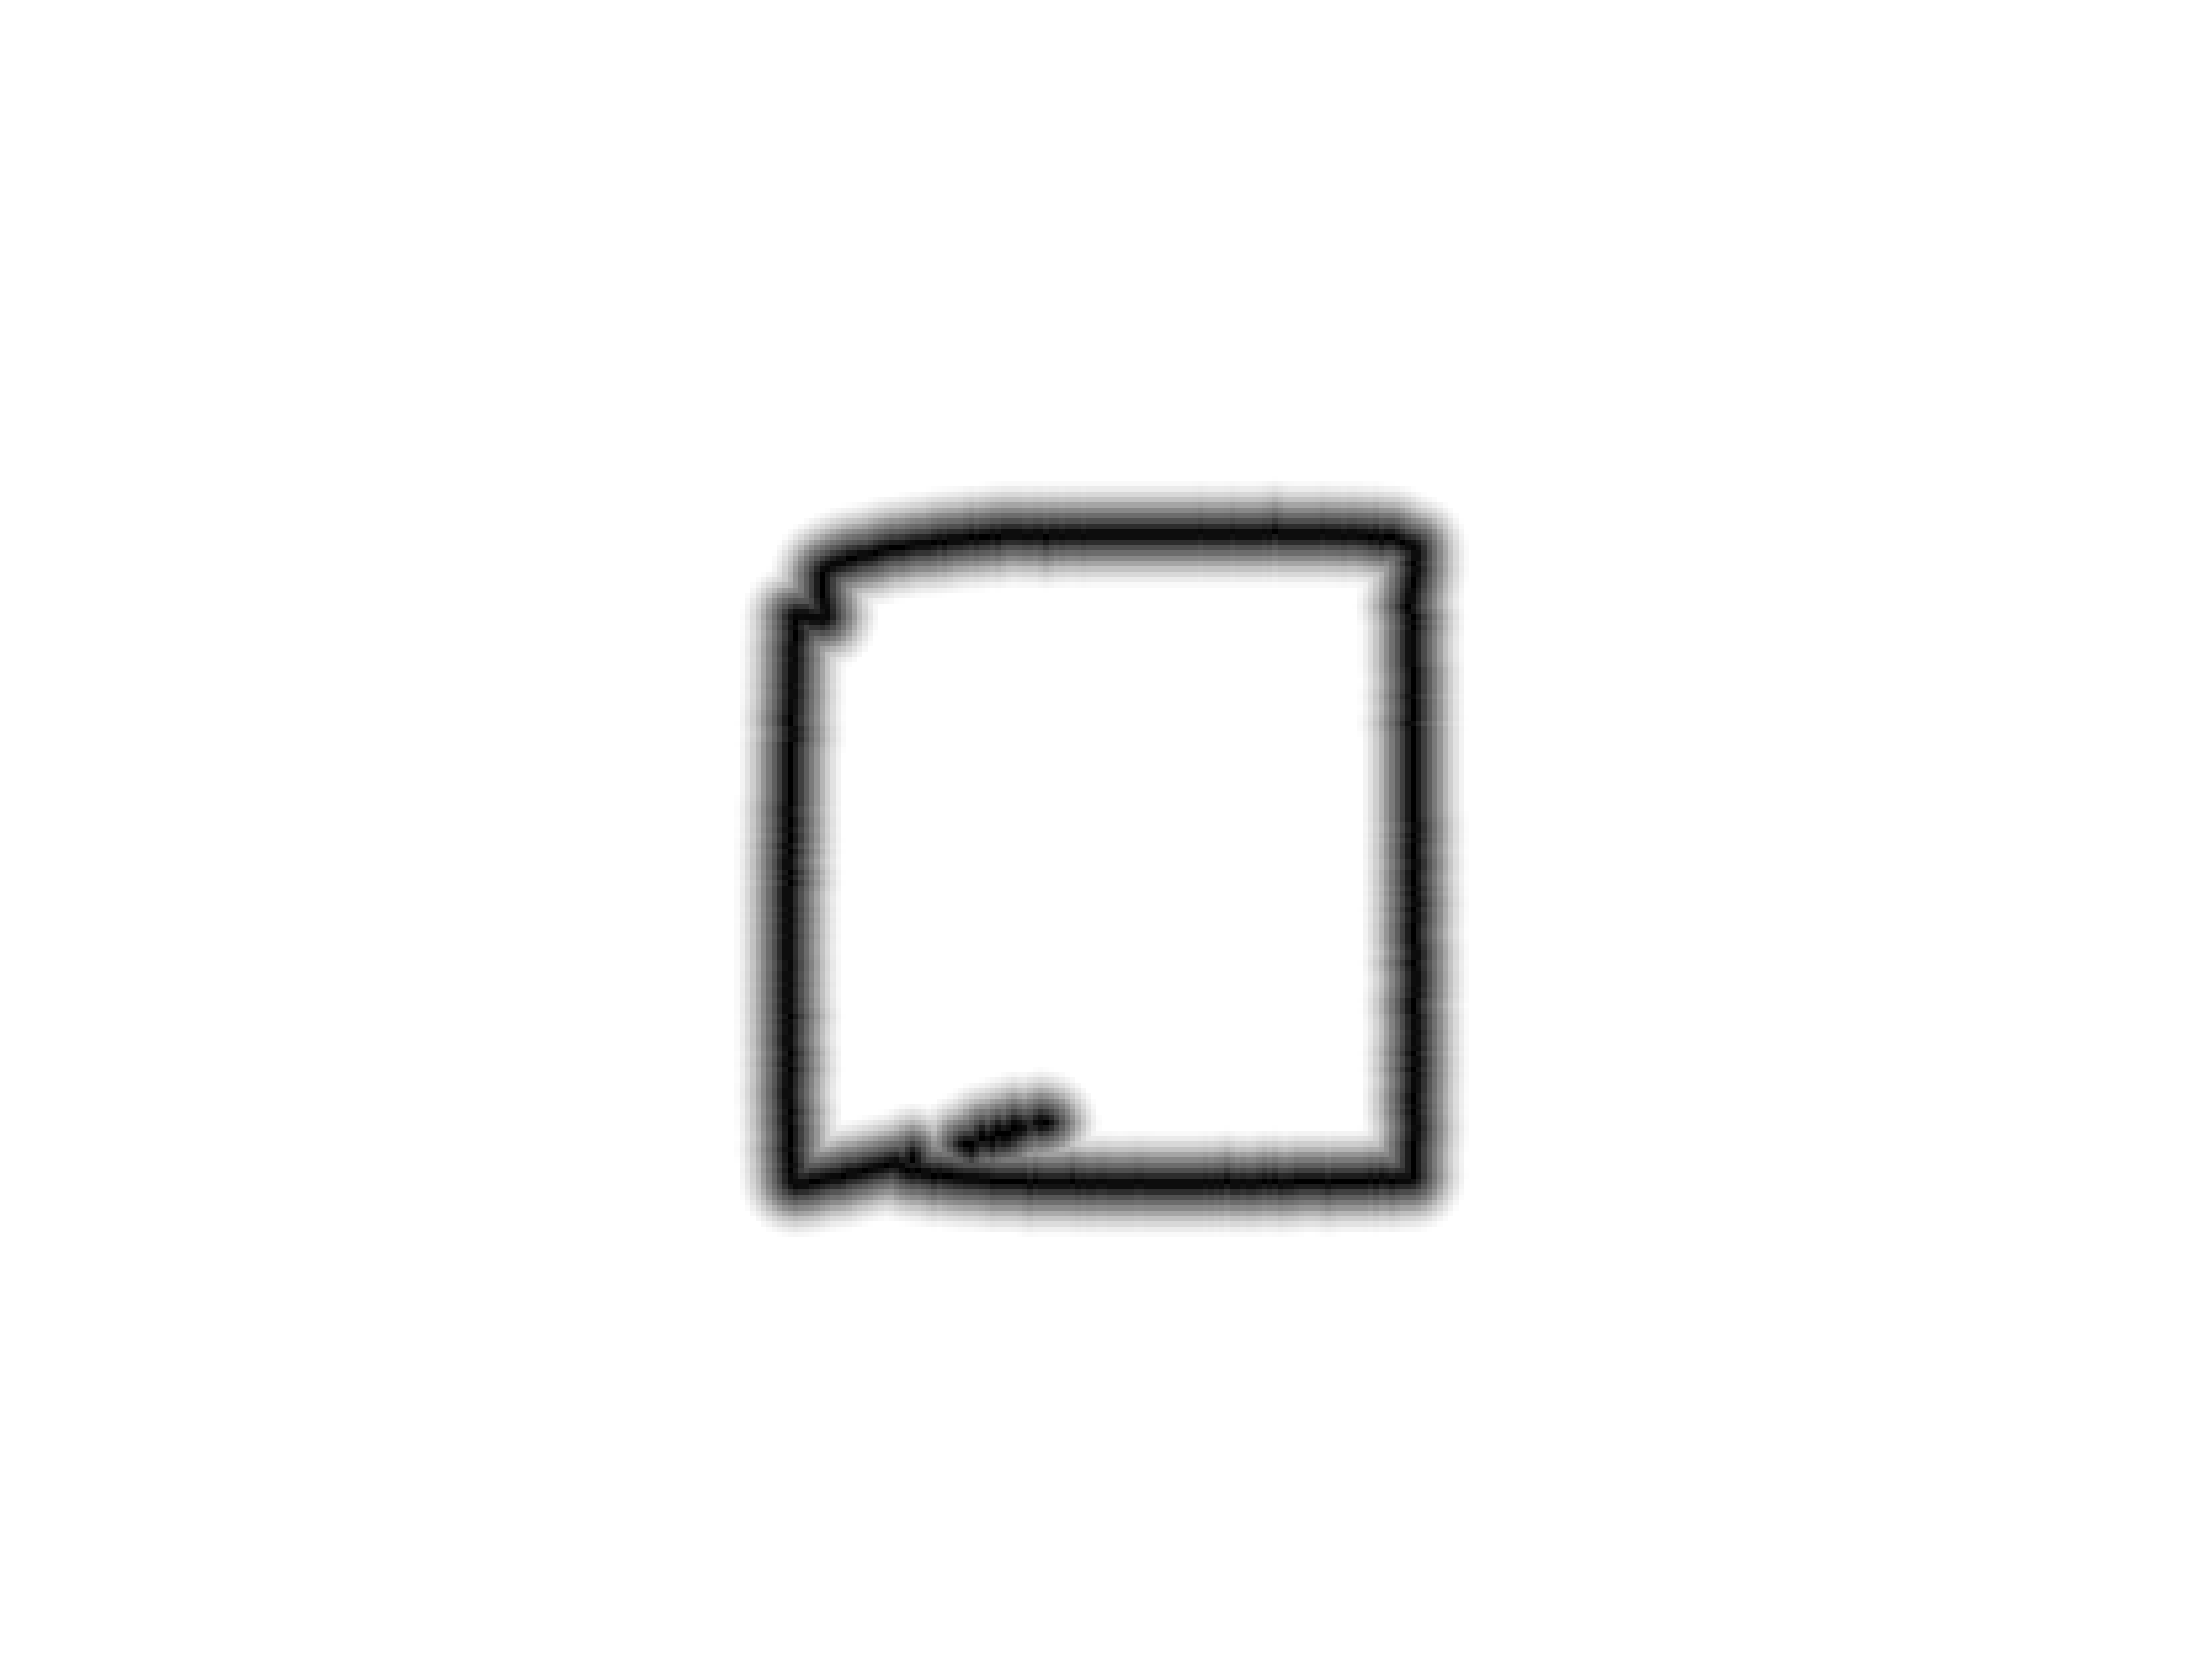
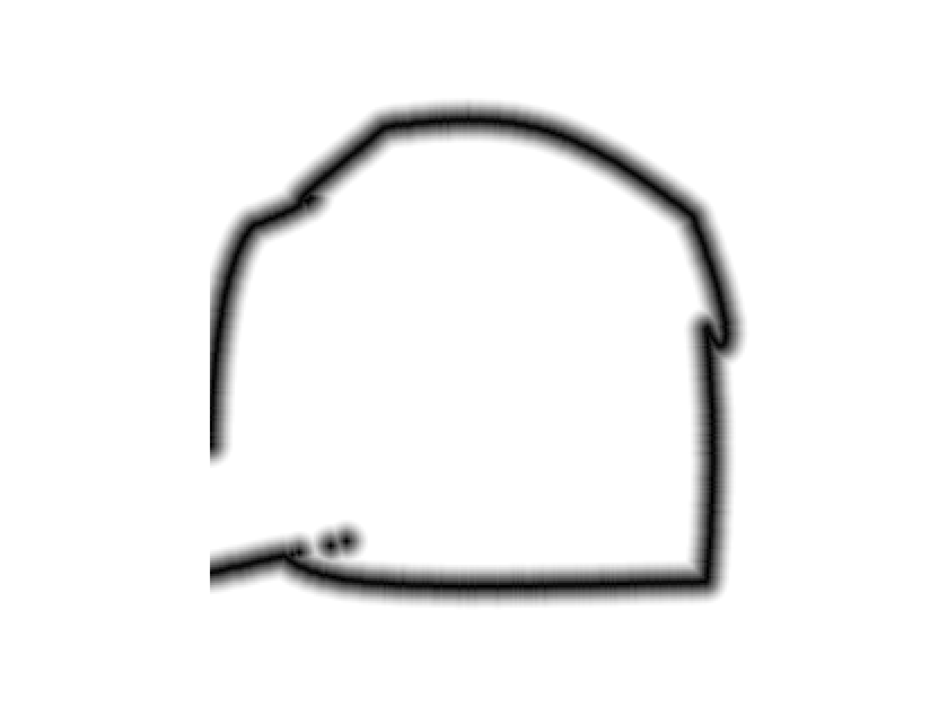
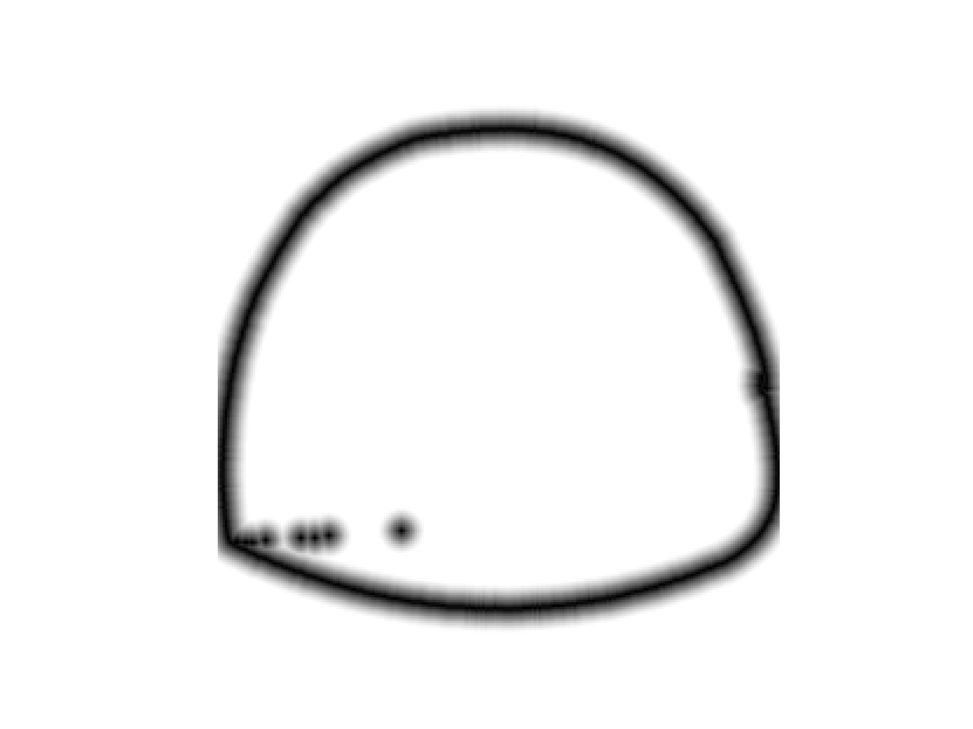
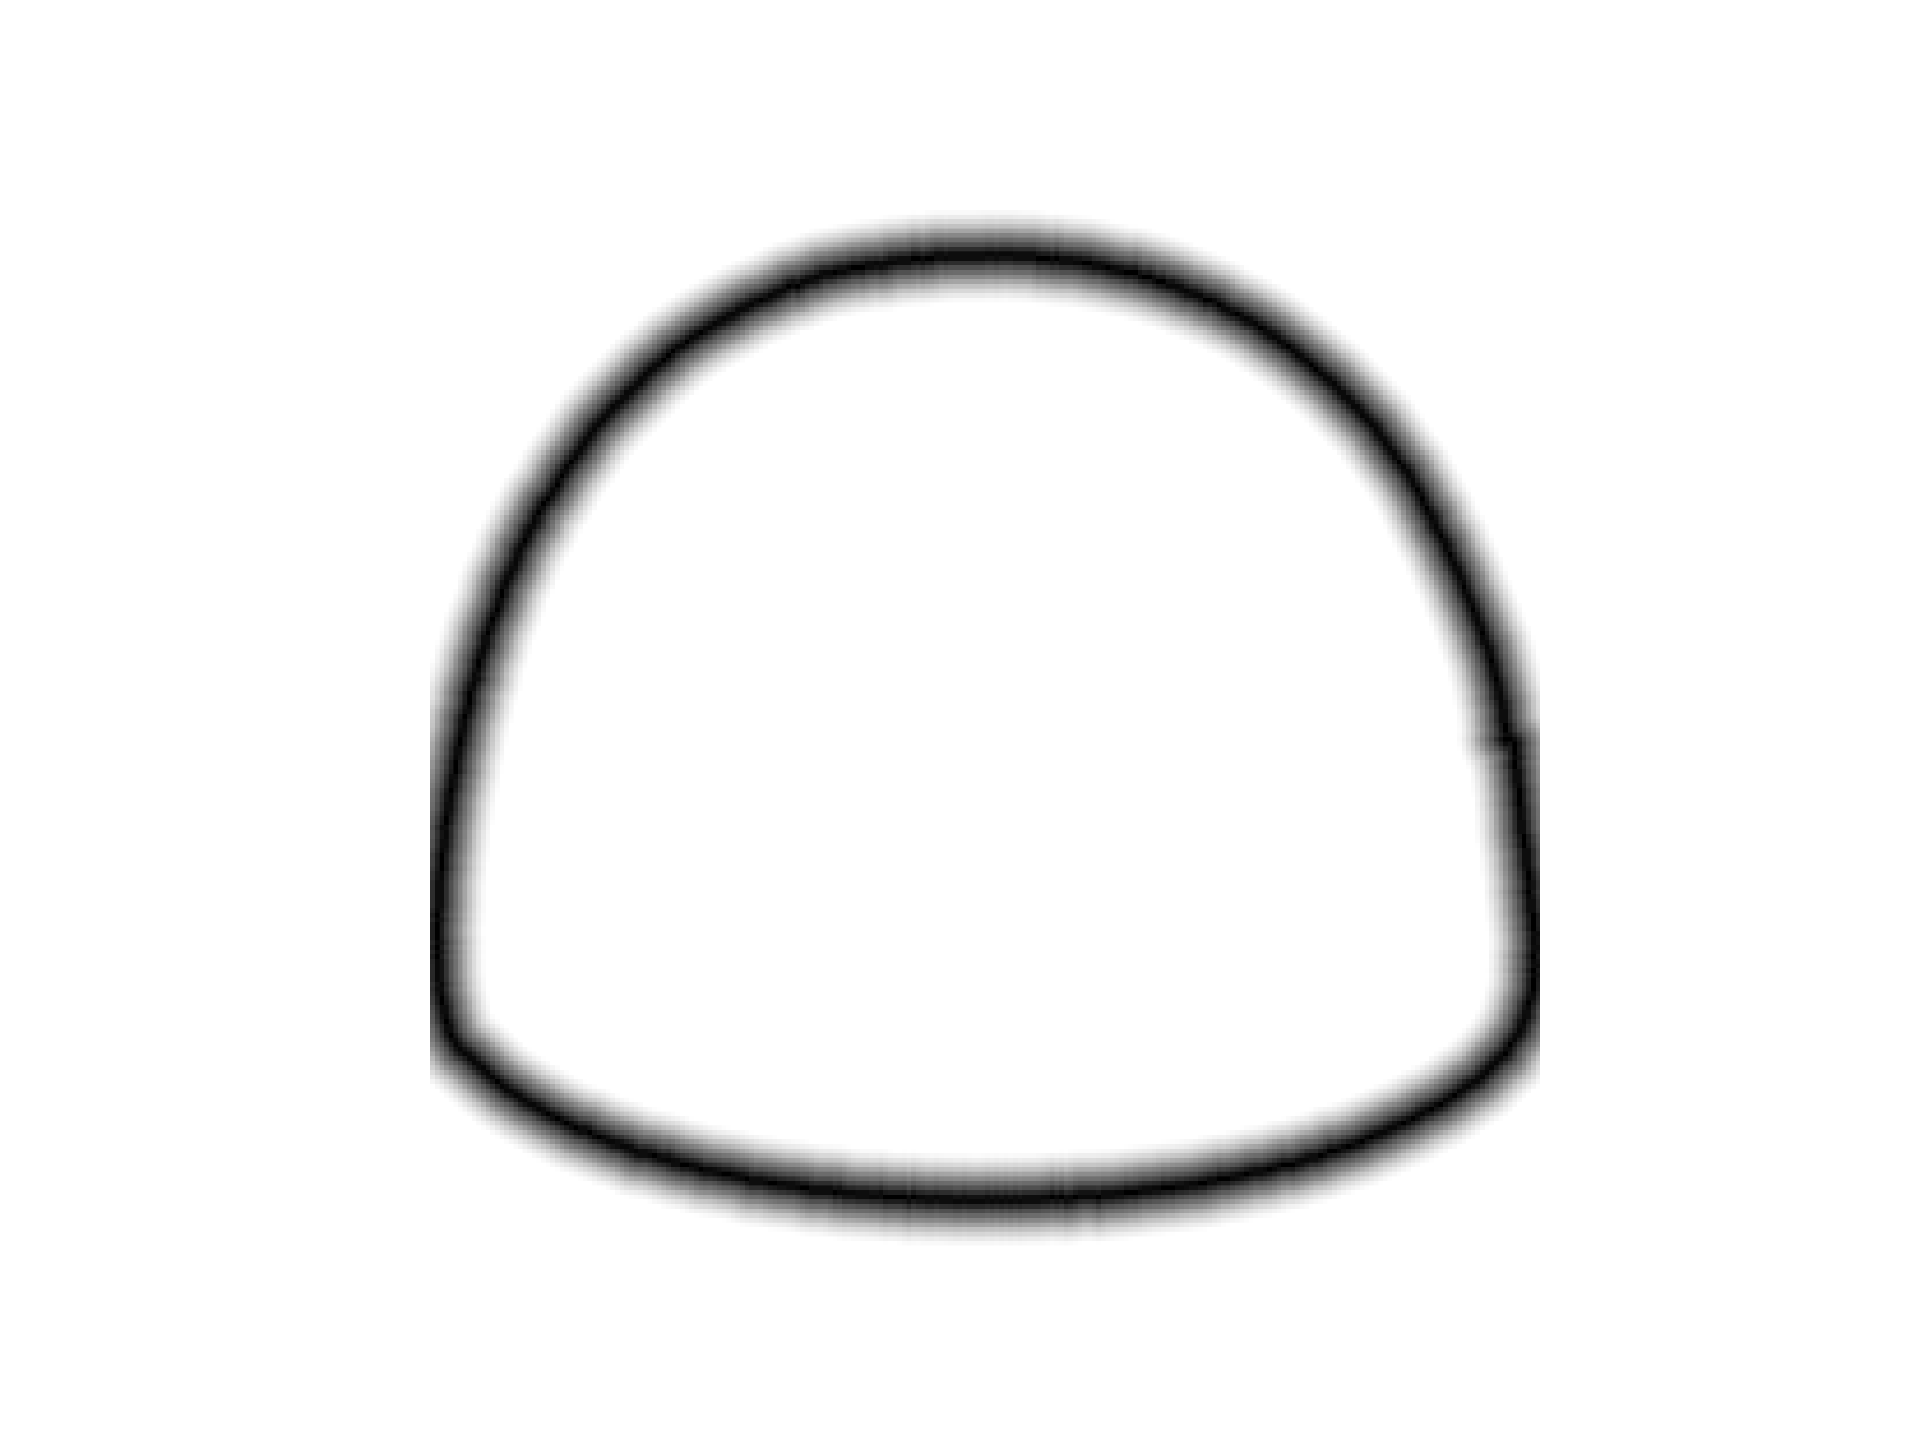
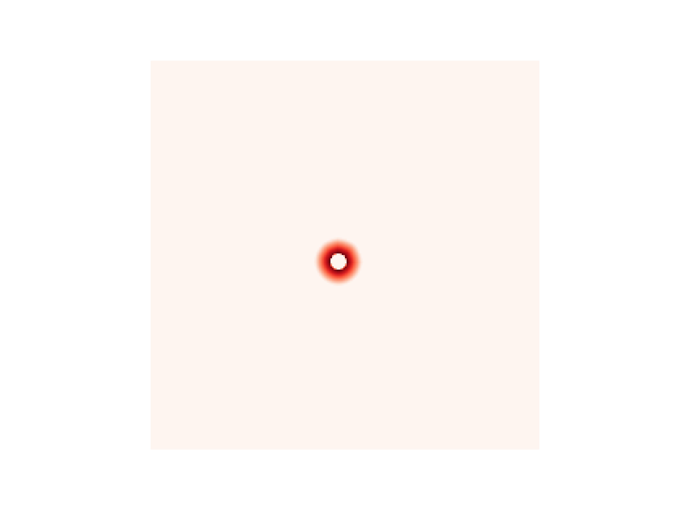
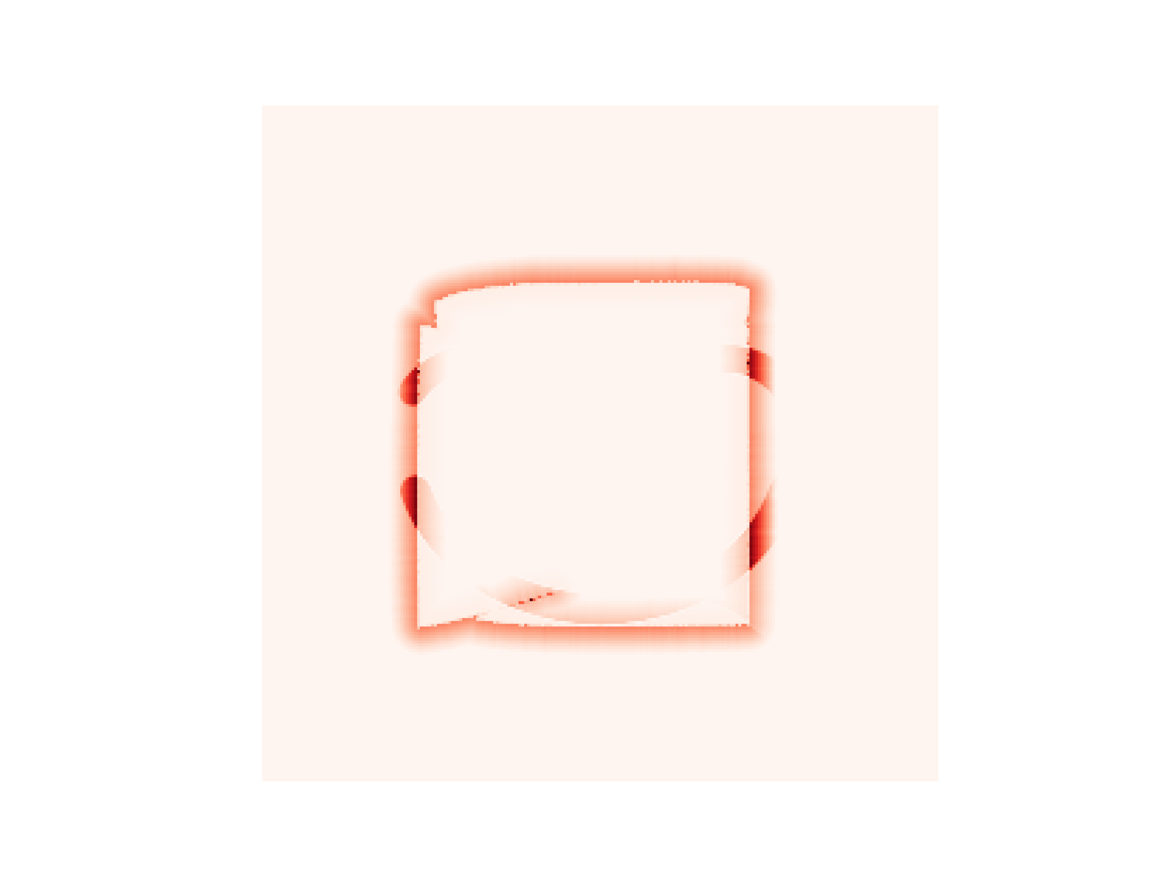
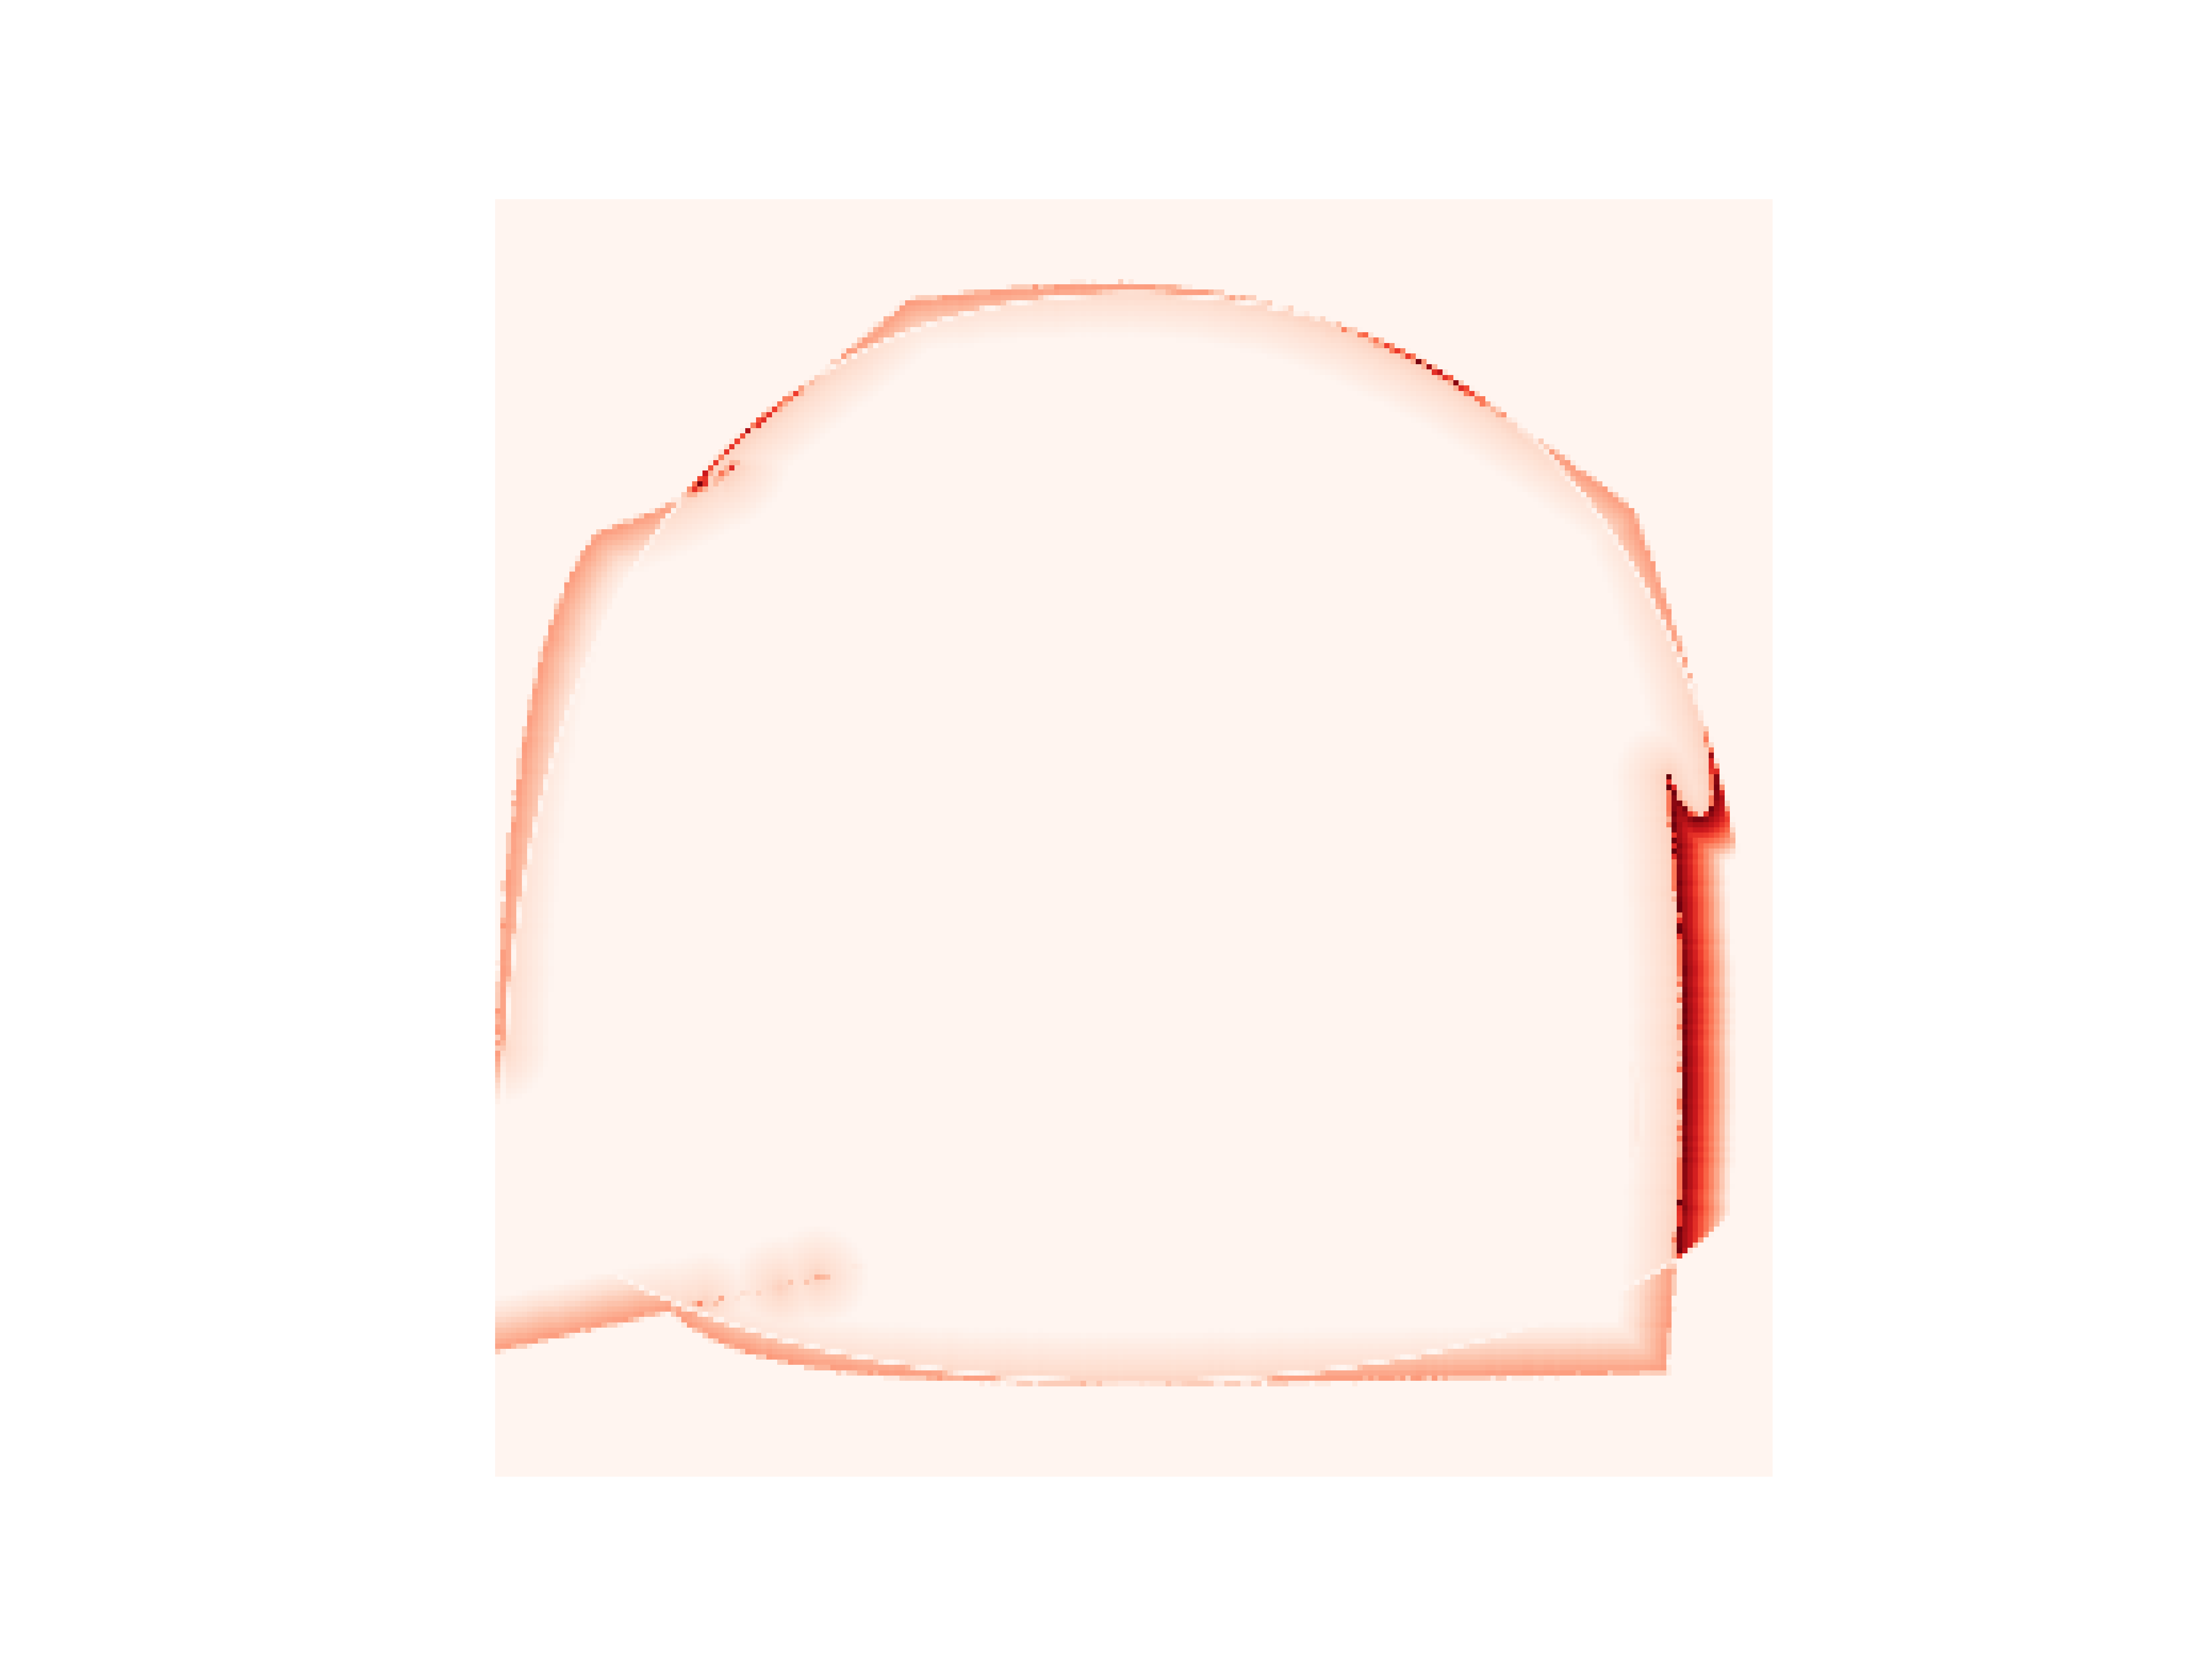
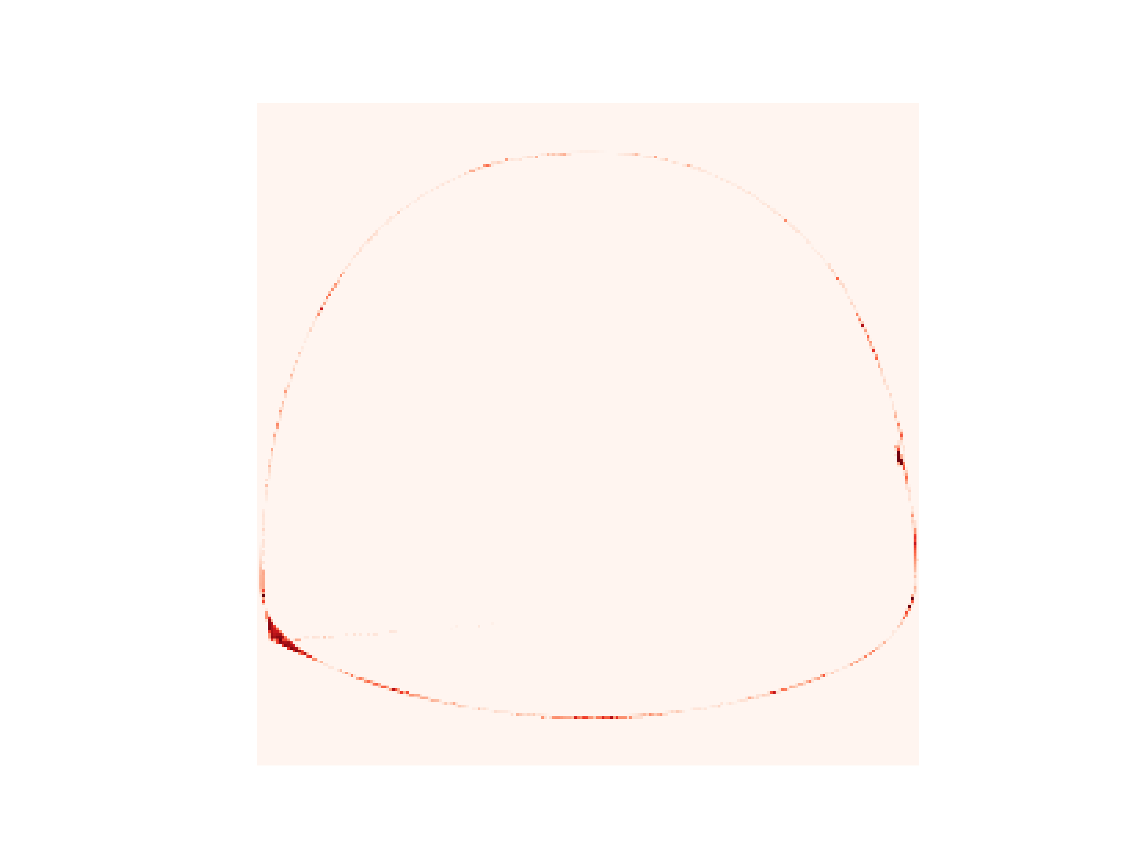
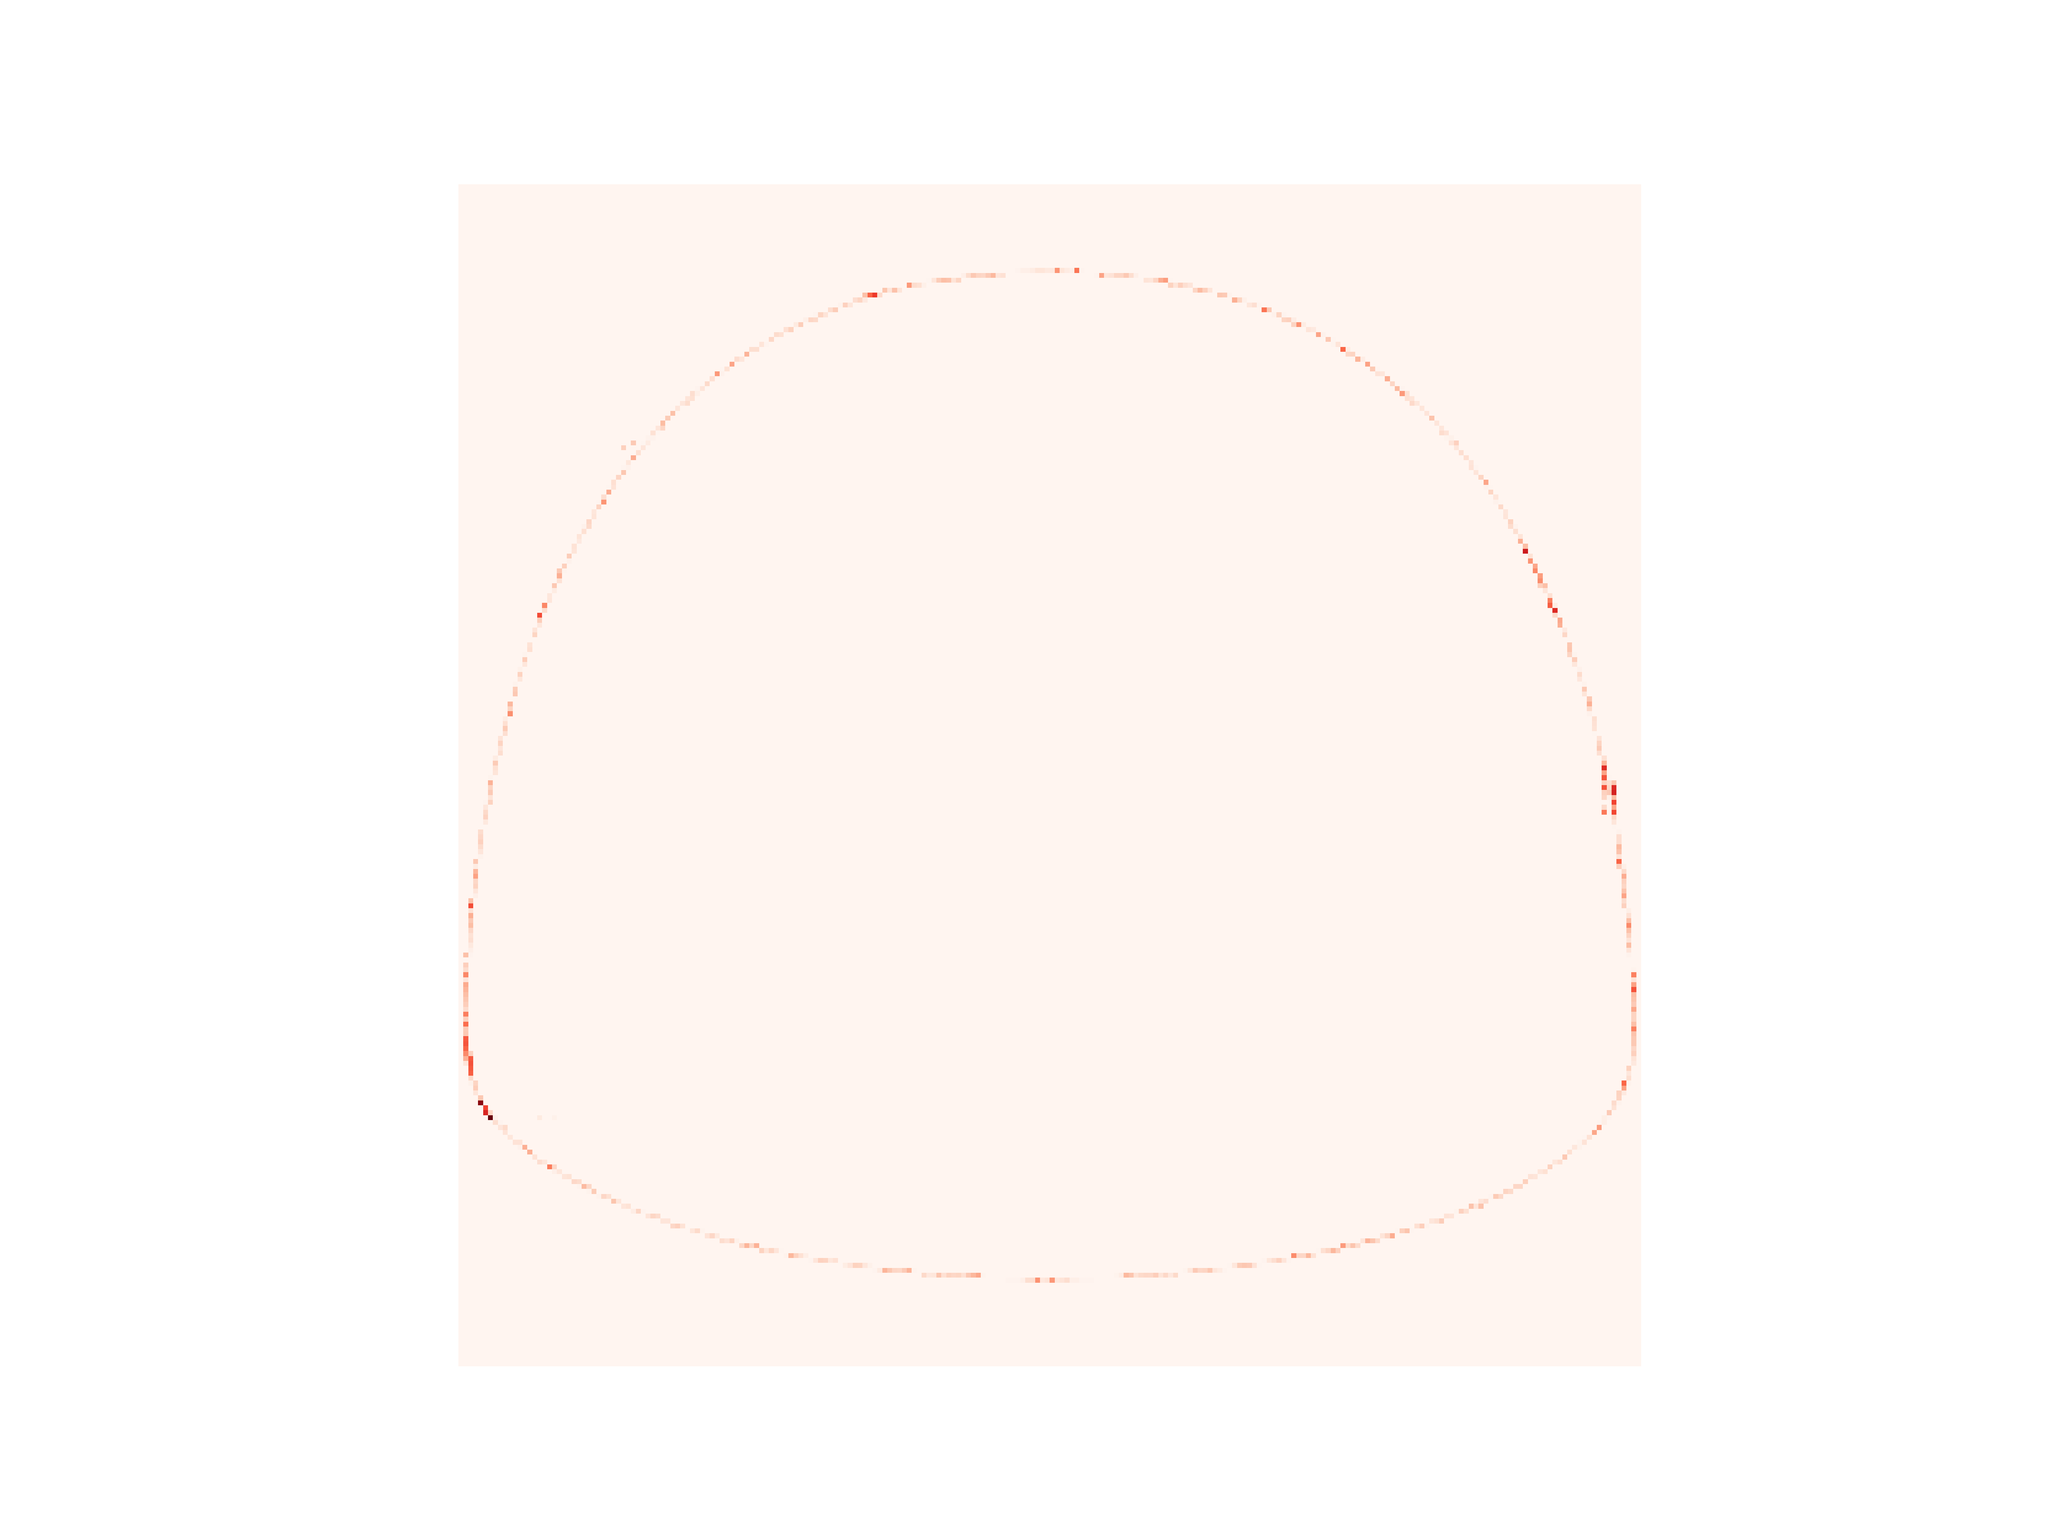


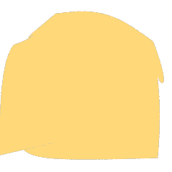
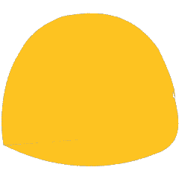

MSE loss
UD weight
UD loss
Shape
Iter. 1
Iter. 50
Iter. 100
Iter. 150
Iter. 200

Slide 9

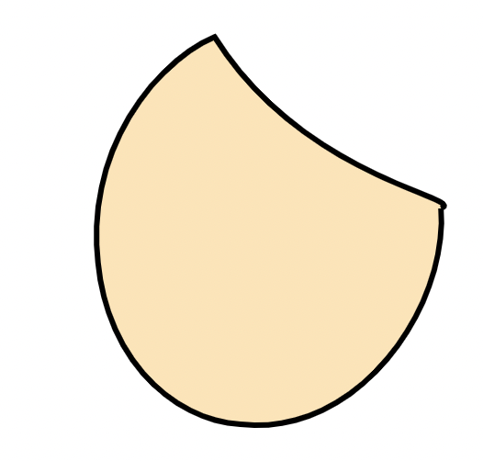
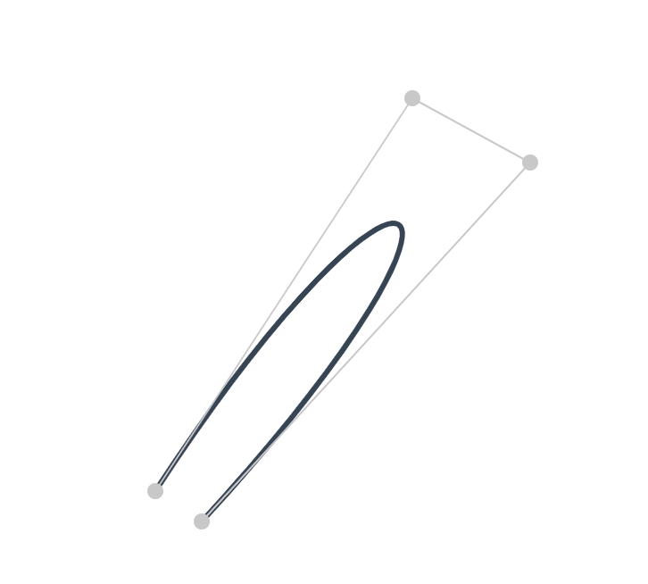
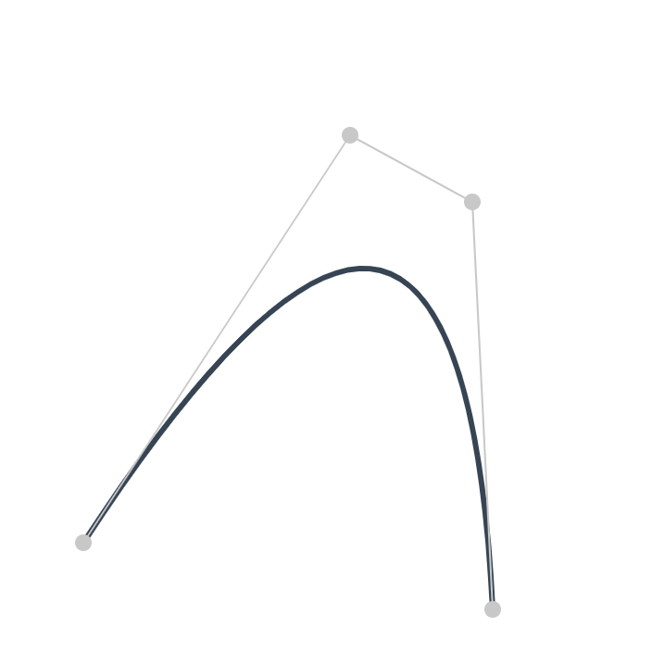


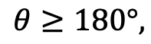
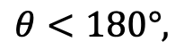
B
B
$$θ$$
C
$$θ$$
C
A
$$θ<180°,$$
A
$$θ≥180°,$$
D
Prone to self-interaction.
D
Prone to convex.

Slide 10
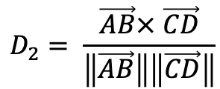
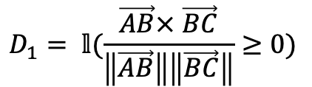



X-ing Loss to avoid self-intersection
B
B
$$θ$$
C
$$θ$$
C
$$\sin{θ}$$
$$D_{1}= 𝕝(\frac{\vec{AB}× \vec{BC}}{\left\|\vec{AB}\right\|\left\|\vec{BC}\right\|}≥0)$$
$$D_{2}= \frac{\vec{AB}× \vec{CD}}{\left\|\vec{AB}\right\|\left\|\vec{CD}\right\|}$$
A
D
A
$$ℒ=D_{1}\left(ReLU\left(−D2\right)\right)+(1−D1)(ReLU\left(D2\right))$$
D

Slide 11






































































LIVE
DiffVG
LIVE
DiffVG
LIVE
DiffVG
LIVE
DiffVG
Raster Input
SVG out (from 1 to 8 paths)

Slide 12



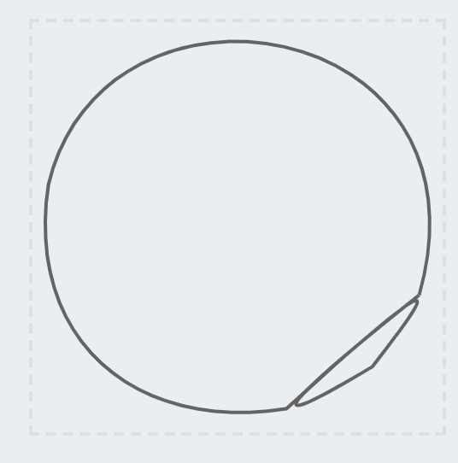


Slide 13


Without Xing loss
With Xing loss

Slide 14



Slide 15



















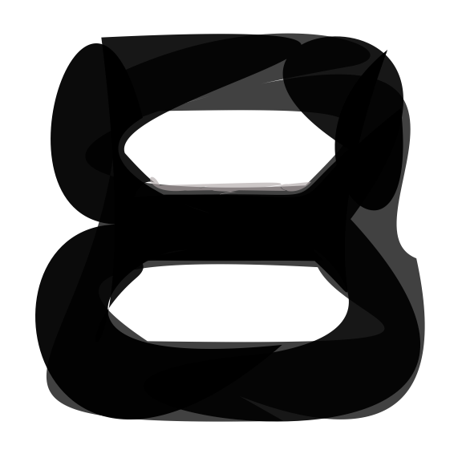
Input
ImageVAE
SVG-VAE
DeepSVG
Im2Vec
Ours

Slide 16






Input
Seg4
Seg8
Seg12
Seg16
Seg20

Slide 17


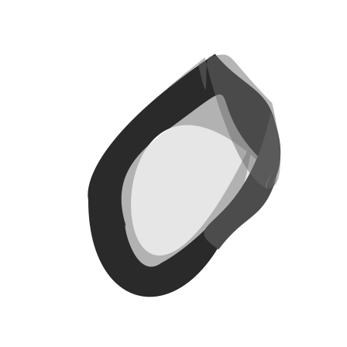
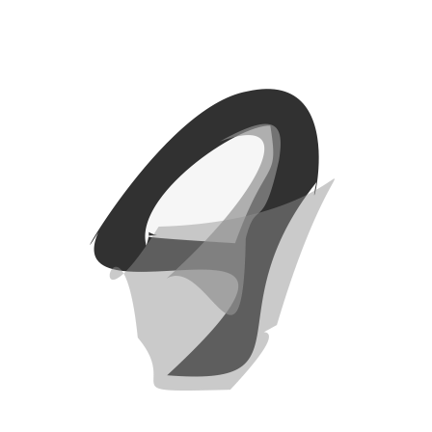
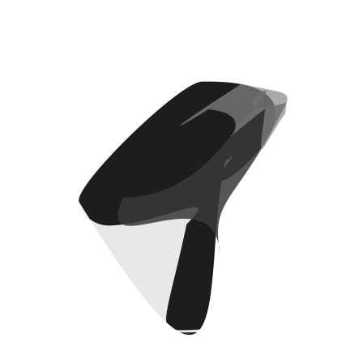


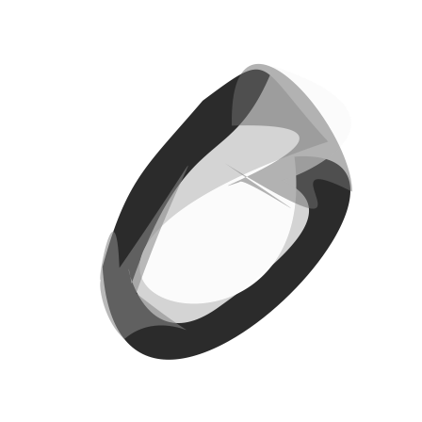
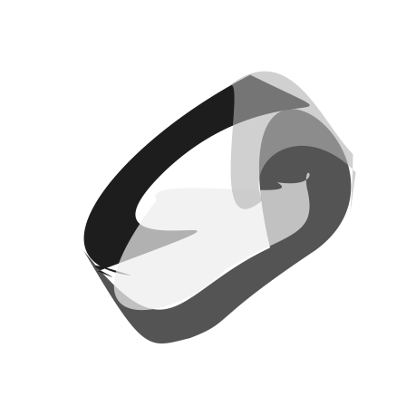


4
6
8
2

Slide 18














1 3 5 7 9
4
6
8
2

Slide 19







1
8
16
4
32
64
128

Slide 20







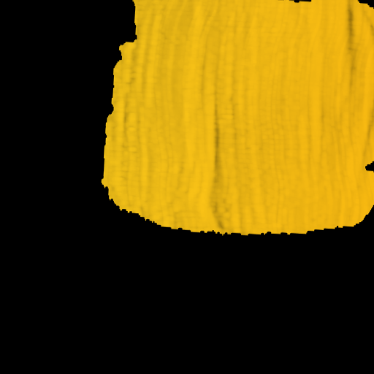
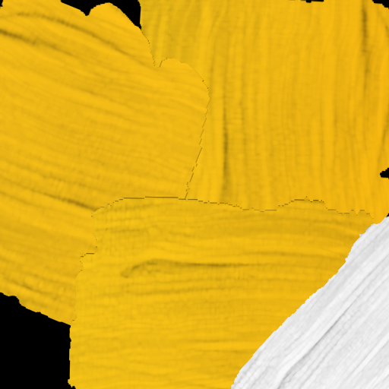
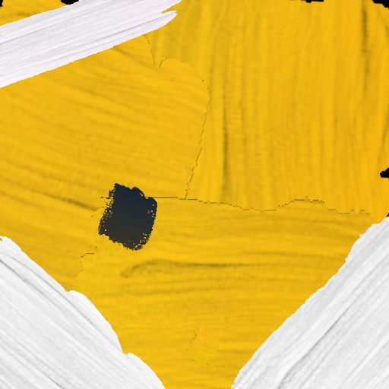
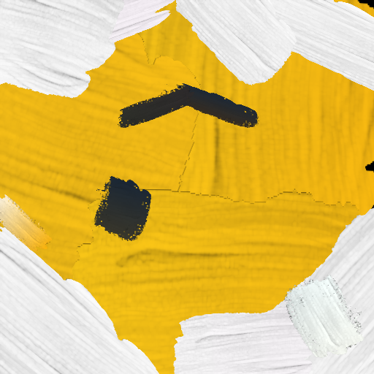
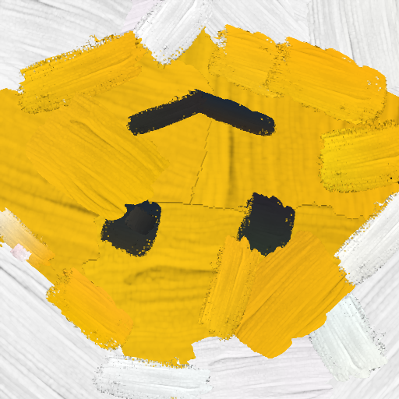
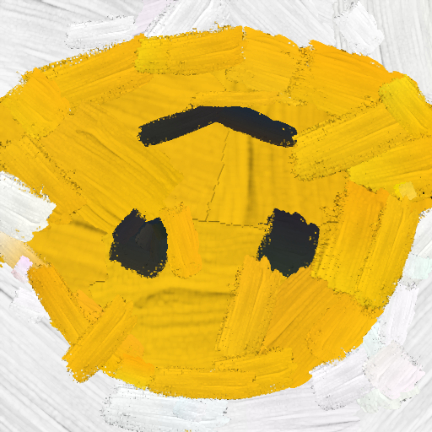






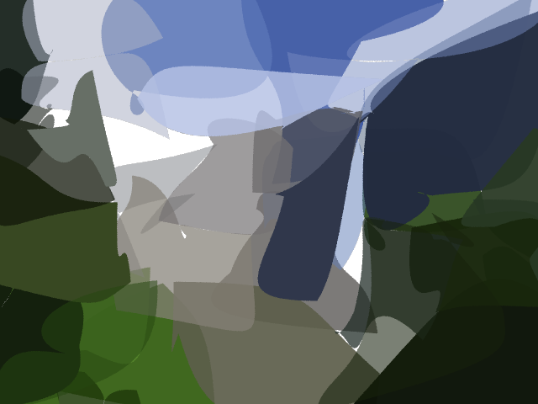
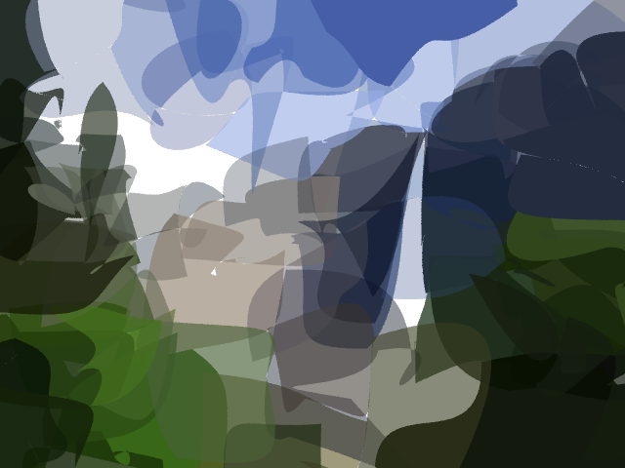
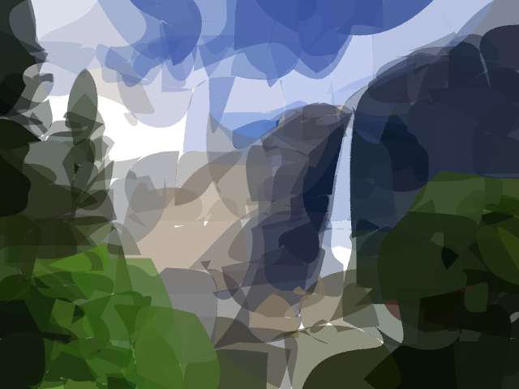
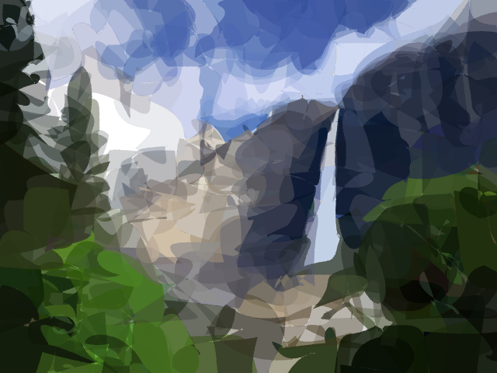

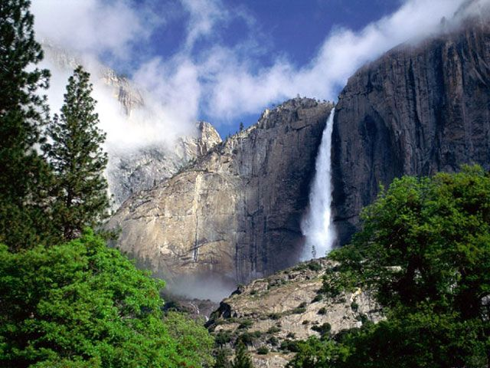
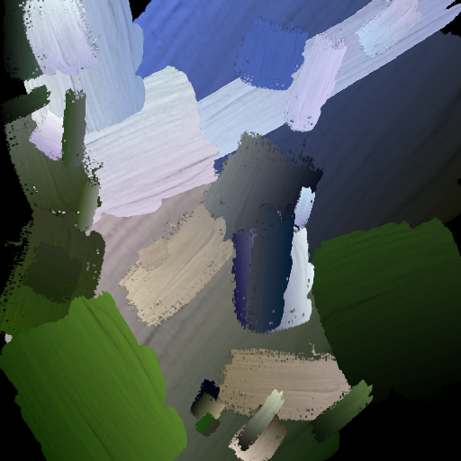
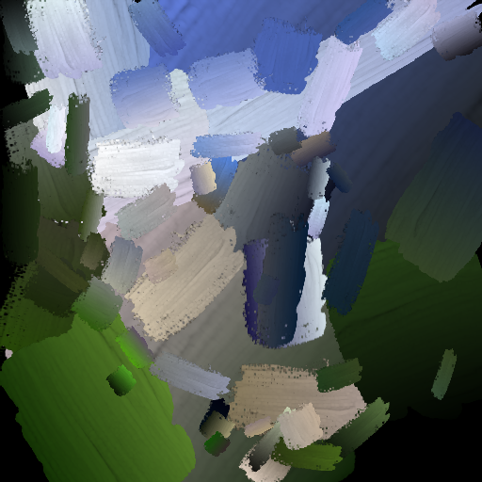








DiffVG
Target
Painter
LIVE
N=1
N=4
N=8
N=16
N=32
N=64
DiffVG
Target
Painter
LIVE
N=32
N=64
N=128
N=256
N=512

Slide 21
Without Xing Loss
With Xing Loss (1e-2)

Slide 22







Slide 23













Slide 24












Slide 25



Slide 26



Slide 27



Slide 28



Slide 29



Slide 30



Slide 31



Slide 32



Slide 33



Slide 34



Slide 35



Slide 36



Slide 37

$\left[\begin{matrix}1 & 2 \\ 3 & 4 \\ 5 & 6\end{matrix}\right]→$ $\left[\begin{matrix}5 & 6 \\ 3 & 4 \\ 1 & 2\end{matrix}\right]$

Slide 39




Slide 40

























Segment=4
Segment=5
Segment=6
Input
Weight=0
Weight=0.01
Weight=0.1
Weight=1

Slide 41




































Input
Layer-wise Image Vectorization (from left to right)

Slide 42




X-ing Loss to avoid self-intersection
B
B
$$θ$$
C
$$θ$$
C
$$\sin{θ}$$
$$D_{1}= 𝕝(\frac{\vec{AB}× \vec{BC}}{\left\|\vec{AB}\right\|\left\|\vec{BC}\right\|}≥0)$$
$$D_{2}= \frac{\vec{AB}× \vec{CD}}{\left\|\vec{AB}\right\|\left\|\vec{CD}\right\|}$$
A
D
A
$$ℒ=D_{1}\left(ReLU\left(−D2\right)\right)+(1−D1)(ReLU\left(D2\right))$$
D

Slide 43




Results Comparison on our dataset
Without Xing Loss
With Xing Loss (1e-2)
Without Xing Loss
With Xing Loss (1e-2)

Slide 44


Failure Cases
It follows the rules defined by the loss, but self-intersection still exist.
We need a stricter loss to constrain each segments to avoid (returning back lines)
Under the strict loss, more segments begin to help

Slide 45

Stricker?
B
B
$$θ$$
C
$$θ$$
C
A
D
A
Only allow 90 $θ$ degree segments (using sqrt function to constrain the loss range)
D

Slide 46






Stricker Xing Loss?
Without Xing Loss (1e-2)
Without Xing Loss v1
Without Xing Loss v2

Slide 47




Still some problems here…

Slide 48




















Input
Im2Vec
DiffVG
ours

Slide 49
















DiffVG
Painter
LIVE
N=8
N=16
N=32
N=64
N=128

Slide 50
















DiffVG
Painter
LIVE
N=8
N=16
N=32
N=64
N=128

Slide 51
















DiffVG
Painter
LIVE
N=8
N=16
N=32
N=64
N=128

Slide 52
















DiffVG
Painter
LIVE
N=8
N=16
N=32
N=64
N=128

Slide 53
















DiffVG
Painter
LIVE
N=8
N=16
N=32
N=64
N=128

Slide 54
















DiffVG
Painter
LIVE
N=16
N=32
N=64
N=128
N=256

Slide 55
















DiffVG
Painter
LIVE
N=8
N=16
N=32
N=64
N=128

Slide 56
















DiffVG
Painter
LIVE
N=8
N=16
N=32
N=64
N=128

Slide 57
















DiffVG
Painter
LIVE
N=8
N=16
N=32
N=64
N=128

Slide 58



















DiffVG
Painter
Raster Input
LIVE
N=4
N=16
N=32
N=64
N=196
DiffVG
Painter
Raster Input
LIVE
N=32
N=64
N=128
N=256
N=512

Slide 59


















































Slide 60


























N=4
N=20
N=4
N=20
N=4
N=20
Input
Im2Vec
DiffVG
LIVE

Slide 61










DiffVG
Painter
LIVE
N=10
N=20
N=30
N=40
N=50

Slide 62










DiffVG
Painter
LIVE
N=32
N=64
N=128
N=256
N=512

Slide 72
A | B
B | C
A | B | C | D | E
C | D
D | E
E | A

